Slide 1


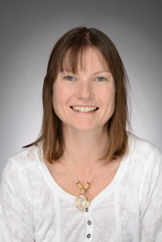
Letchmore Infants’ & Nursery School
NURSERY
Week Commencing 1st December 2025
Value of the Month:Togetherness and Tolerance
This week the children will be:
Story focus: ‘’Spots first Christmas’ by Eric Hill. The children will talk about how giving and receiving makes them feel.
This week the children will be decorating a Christmas tree and taking part in the Santa run.
The children will be looking at the value of courage and sharing the story of ‘The polar bear paddle’ and building resilience and keep trying.
We will be making patterned decorations for the nursery in our maths sessions.
The children will be counting objects with a focus on pointing and counting slowly. We will be matching numeral to quantity.
The children will be going to the hall to practice their sogs ready for their performance.
In our phonics session the children will be finding pictures that begin with ‘b’ and placing a bauble on the Christmas Tree.
The children will be designing a hedgehog home for the nursery garden. We will be looking at a range of materials and learning how to join them together. We will be thinking about the emotions of happy and sad.
Nursery Christmas songs will be Tuesday 16th December at 9.15am in the hall, children can wear a Christmas/festive jumper.
At Home you could:
Make a set of 4 toys pointing and counting carefully. If you add another one how many will you have. Share your nursery reading book. Talk about the author of the book. Make your own hedgehog home. Make a Christmas decoration and bring it in to show.
Please can parents bring in any junk modelling boxes, containers, material for our hedgehog house building. Thank you.
Nursery Staff & Further Information
Class Teacher: Mrs Amanda Donald
Teaching Assistants: Mrs Jenny Georgieva HLTA
Mrs Sarah Thomas TA
Mrs Jo Seaton TA
Mrs Luigina Hamer TA
Miss Leanne Dolby TA
If you have any questions please email Nursery on:
nursery@letchmore.herts.sch.uk or via admin@letchmore.herts.sch.uk

