Slide 1
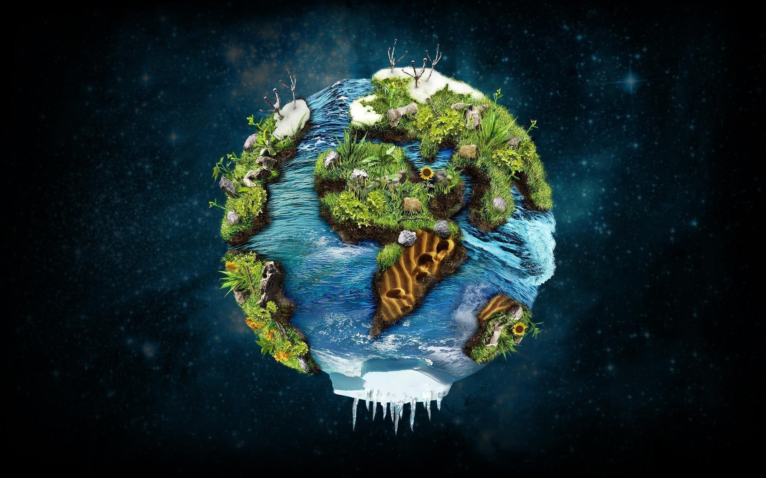

Maths:
Daily practice, counting, calculating and describing using the correct mathematical language.
Counting Objects to 100
Representing numbers to 100
Tens and ones
Comparing numbers.
Adding and Subtracting 1s.
Adding and subtracting 10s.
Adding and subtracting a 2digit and a 1 digit number.
Adding and subtracting 2 2digit numbers.
Solving word problem.
Counting money
Counting in 2s, 3s, 5s and 10s.
Skills-
Count, read and write numbers to 100 in numerals
Identify, represent and estimate numbers using different representations.
Recognise the place value of each digit in a 2 digit number.
Compare and order numbers from 0 to 100 using<, > and = signs
Recall and use addition and subtraction facts to 20 fluently and derive and use related facts to 100.
Solve problems with addition and subtraction using concrete objects and pictorial representations.
Solve simple problems in a practical context.
Global Learning Goals:
Recycling - Links to PSHE and English
English:
Grammar – nouns, proper nouns, adjectives, verbs – linked to Countries.
‘Here we are’ book – Information posters, Simple sentence structure, Poem about ‘Our Wonderful World’.
‘Dear Earth’ book – questions and question words, verbs, poetry based on interesting verbs.
'The Great Explorer' book – Character description, letter writing , story writing.
'The Search for the Giant Arctic Jellyfish' book -Character Description, wanted posters, travel blog and story writing.
Daily Class Reading – sharing fiction and non-fiction texts.
Phonics – Phase 6 Phonics and common exception words.
Handwriting – practice basic lowercase letter size and formation.
Spelling – daily spelling practice.
Skills-
Develop positive attitudes and stamina for writing by writing for a range of purposes (letter, poetry, information text).
Plan and say out loud what they are going to write.
Use capital and lower case letters and digits of the appropriate size, orientation and formation.
Learn how to use new and familiar punctuation correctly (full stops, capital letters, question marks, commas).
Use and understand grammatical terminology when discussing their writing (e.g. noun, proper noun, verb, adjective, adverb, noun phrases).
Read accurately by blending the sounds in words, including words of two or more syllables.
Listen to, discuss and express views about a wide range of stories and non-fiction.
Explore the sequence and structure of texts.
Discuss and clarify the meanings of words, linking new meanings to known vocabulary.
Modern Foreign Language Opportunities:
Register in languages from around the world.
Year 2
Our Amazing World
Term: Autumn
Science:
Habitats and animals
Identify and name a variety of plants and animals in their habitats including micro habitats.
Observing closely, performing simple tests and using observations to suggest answers to questions and gather and recording data to help in answering questions.
Identify that most living things live in habitats to which they are suited and describe how different habitats provide for the basic needs of different kinds of animals and plants and how they depend on each other.
Describe how animals obtain their food from plants and other animals using the idea of a simple food chain.
Local Links:
Stevenage local area (linked to Geography)
Remembrance walk.
Carol concerts in Holy Trinity Church.
Adaptations of our curriculum:
Pre-teaching of our new vocabulary
Develop our articulation of ideas through oracy
Adaptations including visual scaffolds, sentence starters,detailed modelling and word banks
Revisiting key knowledge
Opportunities to reinforce learning in Child InitiatedLearning
Visual Timetables
Inspirational Day
Visit from Adrian Hall - Arctic Explorer

Slide 2

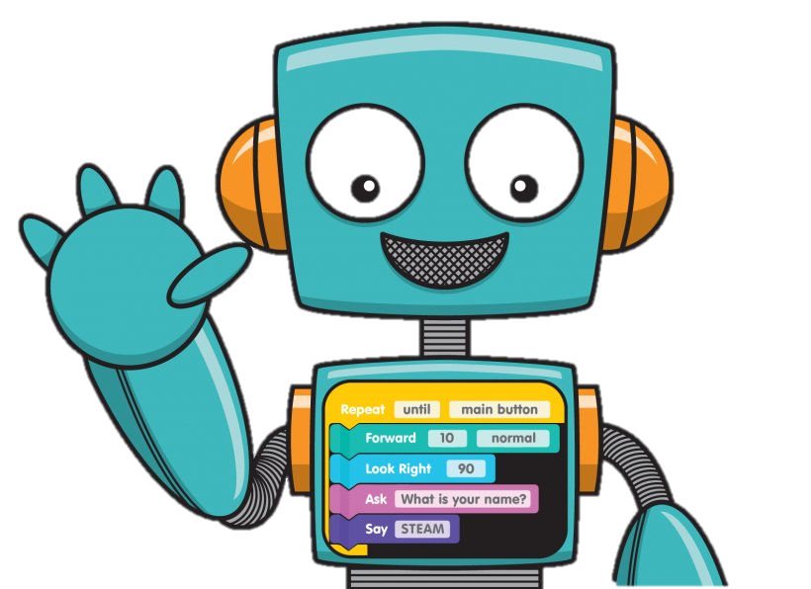
​
History
Know and understand the history of the changes within living memory.
Key events beyond living memory
Learn about the lives of significant individuals in the past who have contributed to national and international developments for example Queen Elizabeth 1st, Martin Luther King Jnr and Ibn Batutta.
Skills:
Understand historical concepts
Understand the methods of historical enquiry
Understand chronological events
Music:
Music New Model Curriculum – interrelated dimensions of music
Skills-
Recognising simple rhythms and patterns.
Listening and singing
Playing instruments percussion instruments
Improvising and composing to a non music stimuli
Performing
Learning tuned instruments – the ocarina
Performing to peers
Whole school performance
Weekly singing assembly
Design Technology:
Design an animal habitat
Design purposeful appealing products for themselves and other based on design criteria.
Select and use a range of equipment to perform practical tasks. Eg cutting, shaping, joining and finishing.
Explore and evaluate their ideas again design criteria.
Year 2
Our Amazing World
Term: Autumn
PE
Sending and receiving To explore how the body moves at different speeds.
To develop changing direction and dodging. To develop changing direction and dodging.
To develop balance, stability and landing safely.
To roll a ball to a target. To roll a ball to a target.
To track and receive a rolling ball. To track and receive a rolling ball.
To send and receive a ball with your feet To send and receive a ball with your feet
Adaptations of our curriculum:
Pre-teaching of our new vocabulary
Develop our articulation of ideas through oracy
Adaptations including visual scaffolds, sentence starters, detailed modelling and word banks
Revisiting key knowledge
Opportunities to reinforce learning in Child Initiated Learning
Visual Timetables

Slide 3

Personal, Social and Emotional Development:
Relationships
Support our pupils’ spiritual, moral, cultural, mental and physical development and prepare them for the opportunities, responsibilities and experiences of life and the next stage of their education.
Help our pupils build their confidence, resilience and self-esteem to keep themselves safe and be prepared for modern life in Britain.
Support our pupils to develop empathy, an understanding of themselves, and the ability to work with others in order to help them form and maintain good and healthy relationships, including friendships and family relationships
Skills-
Strategies for positive play with friends
How to work and play cooperatively in different groups and situations
Sharing ideas and listen to others, take part in discussions and give reasons for views
How to be a good friend
How friends can have both similarities and differences
Different ways to meet and make friends
Similarities and differences with their friends, classmates, and other people
How to recognise hurtful behaviour online
What to do if you experience it
Art:
Recycling art
Collage
Watercolour painting – colour mixing
Skills-
Pupils use drawing, painting to develop and share their ideas,
experiences and imagination.
Pupils use a range of materials creatively to design and make products
RE:
Identity and Belonging
Introduce Religions of the world
Christian Signs and Symbols
Understanding important features of a Christian church
Exploring water as a religious symbol
Skills-
Name the main religions of the world.
Identify Christian signs and symbols and explain their importance.
Use symbolism to express their own values and beliefs.
Identify key features of a Christian church and suggest why these are important.
Understand the significance of water as a religious symbol and suggest how it is used in religions around the world.
Geography:
My community and the local area– Pictures of Stevenage
Our local area maps and posters
The United Kingdom and the surrounding seas
The 7 Continents and 5 Oceans
Skills-
To use simple fieldwork and observational skills to study the geography of the school and its grounds and the key human and physical features of its surrounding environment.
Use basic geographical vocabulary to refer to key physical features, including: beach, cliff, coast, forest, hill, mountain, sea, ocean, river, soil, valley, vegetation, season & weather.
Use a world map, atlas or globe to name & locate the 7 continents & 5 oceans.
Use a UK wall map or atlas to locate & identify the 4 countries & capital cities of the UK & surrounding seas.
Year 2
Our Amazing World
Term: Autumn
Computing:
(Primary computing scheme –(Introduction to Purple Mash)
To log onto Purple Mash, create an avatar. To save work and learn how to use 2Dos.
Creating pictures
To create pictures in the style of different artists.
Skills-
To log in and create an avatar.
To save and find work on the computer.
To understand how to complete work in 2Dos in purple mash.
To use computer tools to replicate and create art in style of different artists.
To manipulate a digital image.
To store and retrieve worked saved on computer.
To manipulate software to create a piece of art.
.
.
Adaptations of our curriculum:
Pre-teaching of our new vocabulary
Develop our articulation of ideas through oracy
Adaptations including visual scaffolds, sentence starters,detailed modelling and word banks
Revisiting key knowledge
Opportunities to reinforce learning in Child Initiated Learning
Visual Timetables

